Slide 1
第七章
EIGRP

Slide 2
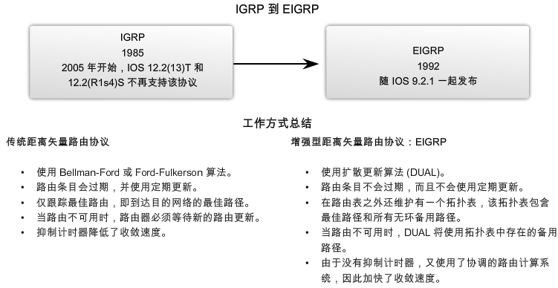
EIGRP历史背景
EIGRP的前身: IGRP

Slide 3
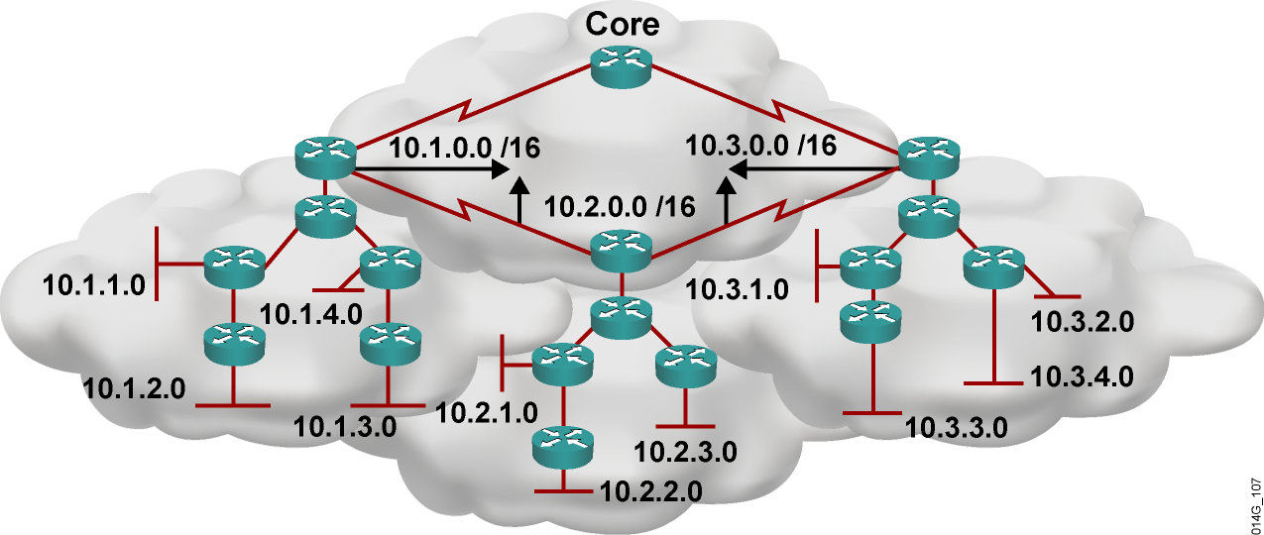
EIGRP特点
  Cisco私有协议
  高级距离矢量协议，支持最大255。默认100
  收敛最快
  支持VLSM和不连续子网
  路由部分更新
  支持多种网络层协议
  网络设计灵活
  使用广播和组播
  支持手动汇总
  默认使用带宽延迟做度量值，100% 无环路。
  广域网配置简单
  支持等价负载均衡和非等价负载均衡。同时支持6条。

Slide 4
EIGRP的专业术语
邻居发现
可靠传输协议 RTP
DUAL算法
PDM 协议独立模块

Slide 5
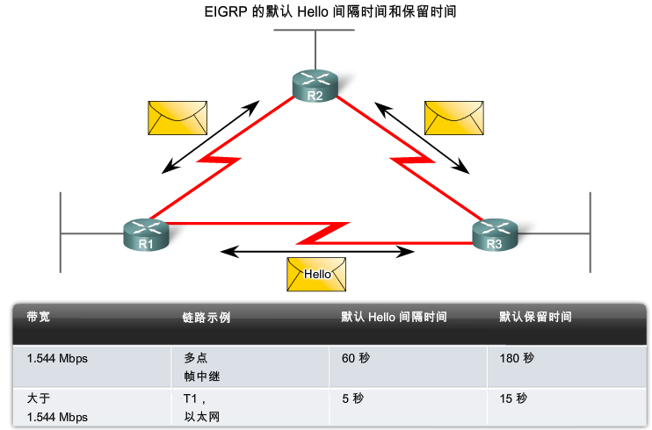
邻居发现
建立邻居关系需要的条件
  收到Hello或ACK
  具有匹配的AS号
  具有相同的K值

Slide 6
RTP
RTP用来发送和接收 EIGRP 路由更新数据包，使用可靠和不可靠两种传输方式，首先使用组播(224.0.0.10)发送，再对没有回应的路由器用单播传递16次。

Slide 7
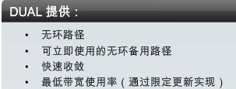
DUAL 概念
Diffusing Update Algorithm (DUAL)
用于最佳路径和备用路径的选择
专业术语
  后继路由器
  可行距离 (FD)
  可行后继路由器 (FS)
  通告距离 (AD)
  可行性条件

Slide 8
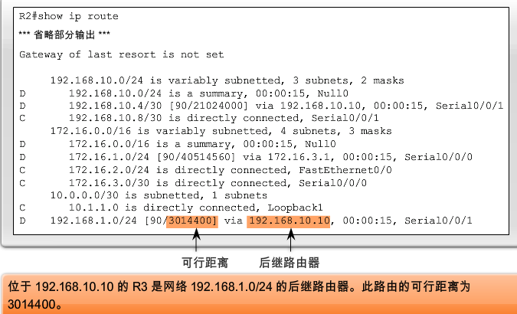
后继路由器和可行距离
后继路由器 (Successor) :最佳路径上的下一跳路由器
可行距离(Feasible Distance | FD):通向目的网络的最低度量

Slide 9
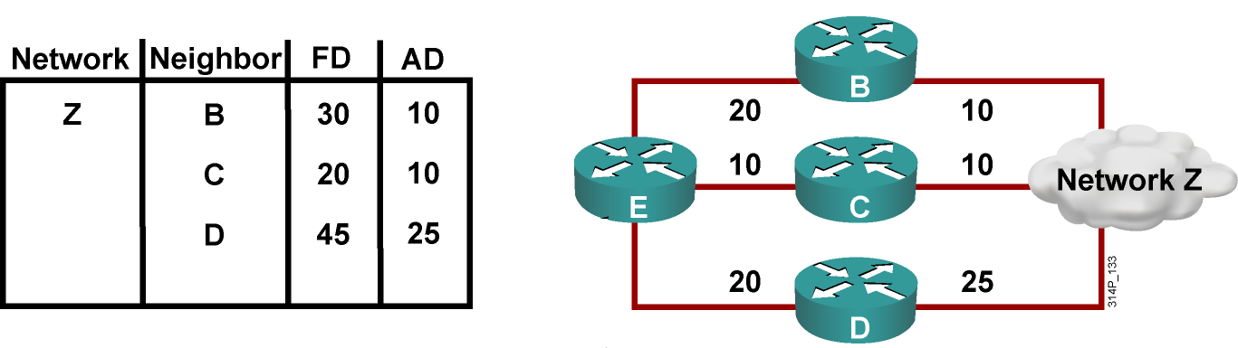
可行后继路由器、可行行条件和通告距离
通告距离(Advertised Distance(AD)：为 EIGRP 邻居通向相同目的网络的可行距离
可行后继路由器 (Feasible Successor) ：指一个邻居，它有一条通向同一目的网络的无环备用路径，并且满足可行性条件。
可行性条件 (FC)：邻居通向一个网络的通告距离比本地路由器通向同一个目的网络的可行距离短。

Slide 10
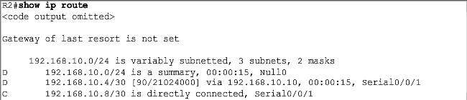
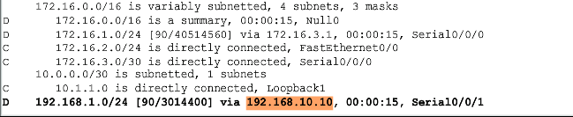
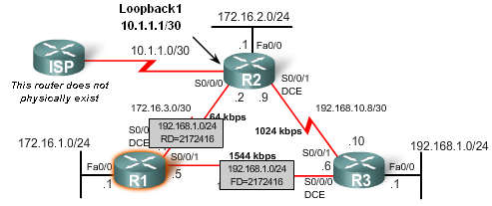
后继和可行距离
Notes:
The feasibility condition (FC) is met when a neighbor's reported distance (RD) to a network is less than the local router's feasible distance to the same destination network. The reported distance or advertised distance is simply an EIGRP neighbor's feasible distance to the same destination network. The reported distance is the metric that a router reports to a neighbor about its own cost to that network.

Slide 11
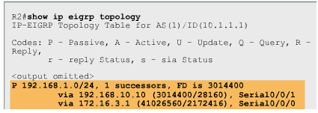
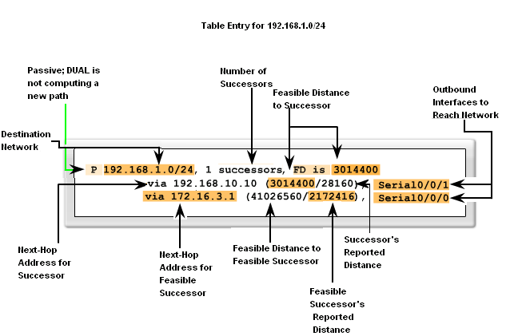
可行距离和通告距离
后继路由器数量
被动
状态
到目的网络可行距离
通向网络的出站接口
目的网络
到目的网络的可行距离
后继路由器的报告距离
后继路由器的下一跳地址
可行路由器的下一跳地址
可行路由器的报告距离

Slide 12
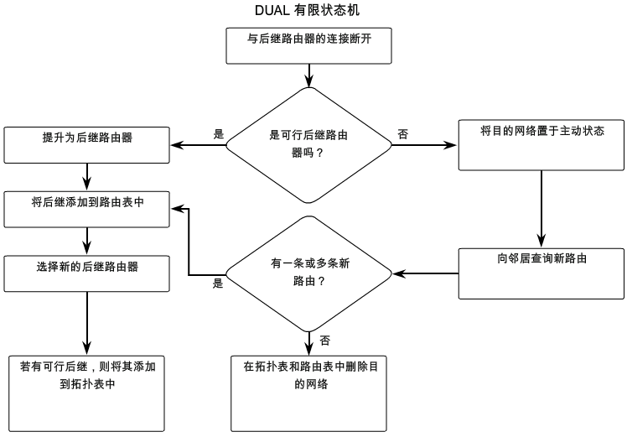
有限状态机和查询

Slide 13
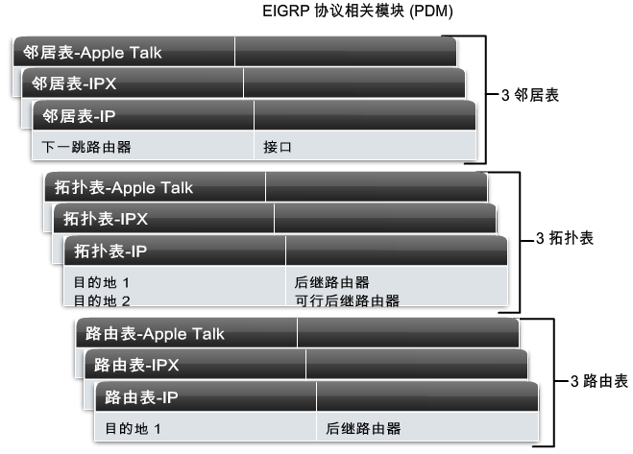
协议相关模块(PDM)
EIGRP为多种网络层协议提供路由支持（IP IPv6 IPX AppleTalk）
每个协议相关模块将维护相互分离的表系列

Slide 14
配置 EIGRP
Router(config)#router EIGRP autonomous-system
指定EIGRP为IP路由协议
Router(config-router)#network network-number
指定可以到达的网络
Notes:
Purpose: This figure explains how to use the router EIGRP and network commands to configure an EIGRP process.
Emphasize: Note that the AS keyword is required for IGRP.
You can use multiple network commands to specify all networks that are to participate in the EIGRP process. Only those networks specified will be published to other routers.

Slide 15

EIGRP 配置举例
Autonomous System = 100
E0
S2
S2
S3
S3
E0
172.16.1.0
A
B
C
192.168.1.0
172.16.1.1
10.1.1.1
10.1.1.2
10.2.2.2
10.2.2.3
192.168.1.1
router EIGRP 100
network 172.16.0.0
network 10.0.0.0
router EIGRP 100
network 192.168.1.0
network 10.0.0.0
router EIGRP 100
network 10.0.0.0
Notes:
Purpose: The figure shows how the EIGRP commands operate on the example network.
Emphasize:
An administrator only specifies directly connected networks that he wishes to publish to other routers.
Without the network command, nothing is advertised. With a network command, the router will advertise every subnet within the Class A, B, or C network specified in the configuration.

Slide 16
查看 EIGRP 信息
E0
S2
S2
S3
S3
E0
172.16.1.0
A
B
C
192.168.1.0
172.16.1.1
10.1.1.1
10.1.1.2
10.2.2.2
10.2.2.3
192.168.1.1
RouterA#sh ip protocols
Routing Protocol is "EIGRP 100"
Sending updates every 90 seconds, next due in 21 seconds
Invalid after 270 seconds, hold down 280, flushed after 630
Outgoing update filter list for all interfaces is
Incoming update filter list for all interfaces is
Default networks flagged in outgoing updates
Default networks accepted from incoming updates
EIGRP metric weight K1=1, K2=0, K3=1, K4=0, K5=0
EIGRP maximum hopcount 100
EIGRP maximum metric variance 1
Redistributing: EIGRP 100
Routing for Networks:
10.0.0.0
172.16.0.0
Routing Information Sources:
Gateway Distance Last Update
10.1.1.2 100 00:01:01
Distance: (default is 100)
Notes:
Purpose: This figure shows how the show ip protocol command is used to monitor EIGRP operation.
Emphasize: The command displays the routing protocols that are active on the router for IP. It also gives network and timer information. In this example, EIGRP is displayed.
Point out the timing information.
Point out the list of networks for which the router is injecting routes.
Point out the administrative distance metric.

Slide 17
查看IP路由表
E0
S2
S2
S3
S3
E0
172.16.1.0
A
B
C
192.168.1.0
172.16.1.1
10.1.1.1
10.1.1.2
10.2.2.2
10.2.2.3
192.168.1.1
RouterA#sh ip route
Codes: C - connected, S - static, I - IGRP, R - RIP, M - mobile, B - BGP
D - EIGRP, EX - EEIGRP external, O - OSPF, IA - OSPF inter area
N1 - OSPF NSSA external type 1, N2 - OSPF NSSA external type 2
E1 - OSPF external type 1, E2 - OSPF external type 2, E - EGP
i - IS-IS, L1 - IS-IS level-1, L2 - IS-IS level-2, * - candidate default
U - per-user static route, o - ODR
T - traffic engineered route
Gateway of last resort is not set
172.16.0.0/24 is subnetted, 1 subnets
C 172.16.1.0 is directly connected, Ethernet0
10.0.0.0/24 is subnetted, 2 subnets
D 10.2.2.0 [90/90956] via 10.1.1.2, 00:00:23, Serial2
C 10.1.1.0 is directly connected, Serial2
D 192.168.1.0/24 [90/91056] via 10.1.1.2, 00:00:23, Serial2
Notes:
Purpose: This figure displays the show ip route command which displays the contents of the router’s IP routing table.
Emphasize: This is the same command presented earlier in the chapter. Discuss the IP routing table in detail. The [100/90956] represent the administrative distance and metric, respectively.
Discuss the following fields:
I—Refers to routes learned from IGRP.
via—Refers to the router that informed us about this route.
00:00:23 timer value—EIGRP updates are every 90 seconds. Ask, “How long until the next update?”
The interfaces to used for the best path.

Slide 18
debug ip EIGRP transaction
命令
E0
S2
S2
S3
S3
E0
172.16.1.0
A
B
C
192.168.1.0
172.16.1.1
10.1.1.1
10.1.1.2
10.2.2.2
10.2.2.3
192.168.1.1
RouterA#debug ip EIGRP transactions
EIGRP protocol debugging is on
RouterA#
00:21:06: EIGRP: sending update to 255.255.255.255 via Ethernet0 (172.16.1.1)
00:21:06: network 10.0.0.0, metric=88956
00:21:06: network 192.168.1.0, metric=91056
00:21:07: EIGRP: sending update to 255.255.255.255 via Serial2 (10.1.1.1)
00:21:07: network 172.16.0.0, metric=1100
00:21:16: EIGRP: received update from 10.1.1.2 on Serial2
00:21:16: subnet 10.2.2.0, metric 90956 (neighbor 88956)
00:21:16: network 192.168.1.0, metric 91056 (neighbor 89056)
Notes:
Purpose: This figure presents the debug ip EIGRP transaction commmand.
Emphasize: The debug ip EIGRP transaction command displays all updates that are sent from and received by your router.

Slide 19
debug ip EIGRP events
命令
E0
S2
S2
S3
S3
E0
172.16.1.0
A
B
C
192.168.1.0
172.16.1.1
10.1.1.1
10.1.1.2
10.2.2.2
10.2.2.3
192.168.1.1
RouterA#debug ip EIGRP events
EIGRP event debugging is on
RouterA#
00:23:44: EIGRP: sending update to 255.255.255.255 via Ethernet0 (172.16.1.1)
00:23:44: EIGRP: Update contains 0 interior, 2 system, and 0 exterior routes.
00:23:44: EIGRP: Total routes in update: 2
00:23:44: EIGRP: sending update to 255.255.255.255 via Serial2 (10.1.1.1)
00:23:45: EIGRP: Update contains 0 interior, 1 system, and 0 exterior routes.
00:23:45: EIGRP: Total routes in update: 1
00:23:48: EIGRP: received update from 10.1.1.2 on Serial2
00:23:48: EIGRP: Update contains 1 interior, 1 system, and 0 exterior routes.
00:23:48: EIGRP: Total routes in update: 2
Notes:
Purpose: This figure presents the debug ip EIGRP events commmand.
Emphasize: When there ar many networks in your routing table, displaying every update for every route can flood the console and make the router unusable.
The debug ip EIGRP events command displays a summary of EIGRP routing messages. This command indicates the source and destination of each update, as well as the number of routes in each update. Messages are not generated for each route.

Slide 20
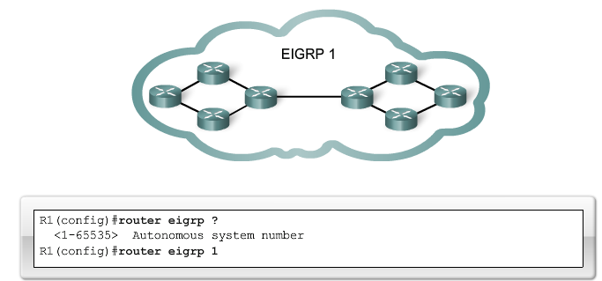
自治系统 (AS) 和进程ID
Router(config)#router eigrp autonomous-system
autonomous-system它实际上起进程 ID 的作用，一个进程 ID 代表各自在路由器上运行的协议

Slide 21
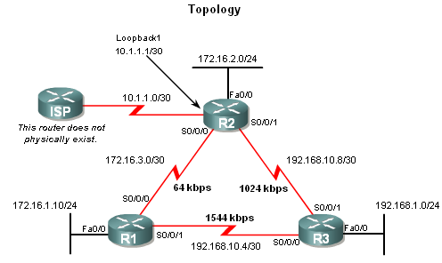
EIGRP在有类边界自动汇总
关闭自动汇总：router(config-router) # no auto-summary

Slide 22


EIGRP 的负载均衡
New Route
Source
Initial
Route
Destination
  最多六条路径
  下一次所要到达的路由器必须接近目的网络
  在允许的参数内选择路径
Notes:
Purpose: The figure presents how EIGRP load sharing improves throughput and increases reliability.
Emphasize: Only feasible paths can be used for EIGRP load sharing.
Load-balancing methods vary according to the switching mode because the data structures for process switching, fast switching, and autonomous switching are all different. When process switching, the processor load balances packet by packet. When fast, autonomous, or silicon switching, load balancing is done destination by destination.
By default, the amount of variance is set to one, which results in equal-cost load balancing.
You can use the default-metric command to change the default metric.
Transition: The following pages describe how to configure the EIGRP routing protocol.

Slide 23
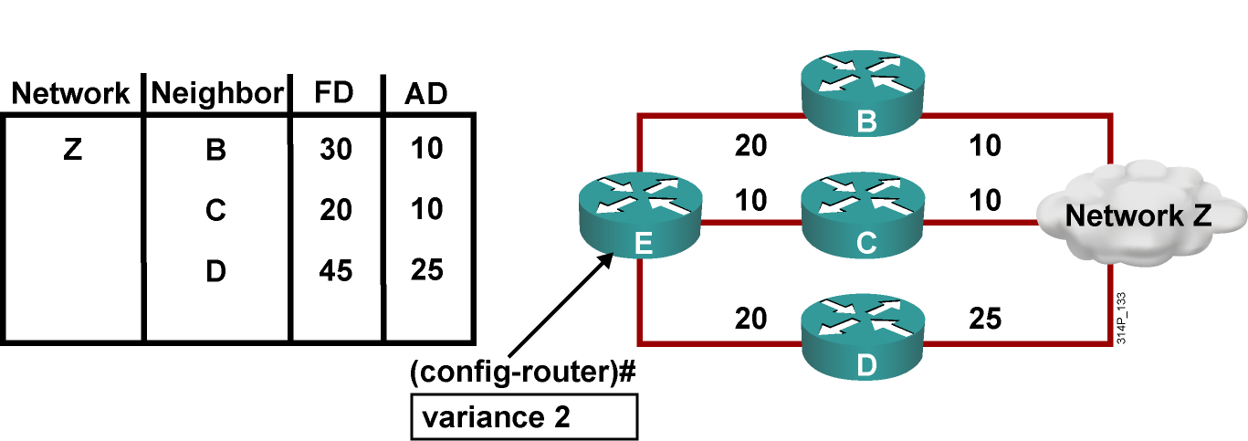
非等价负载均衡

Slide 24
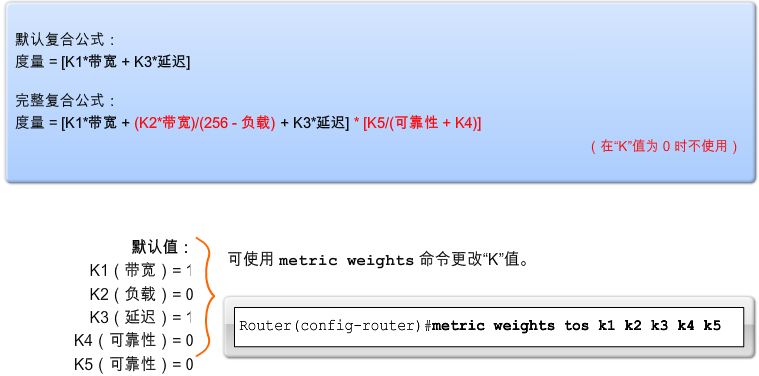
EIGRP 复合度量和K值
复合度量
  带宽（Bandwidth）、延迟,（delay）、可靠性（reliability）、负载（ load）
缺省值
  K1 和 K3= 1 ,所有其他 K 值 0

Slide 25
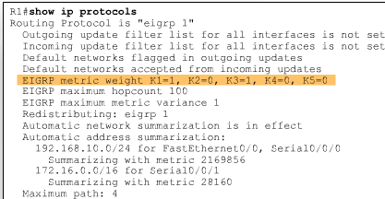
EIGRP 复合度量和K值
检验 K 值

Slide 26
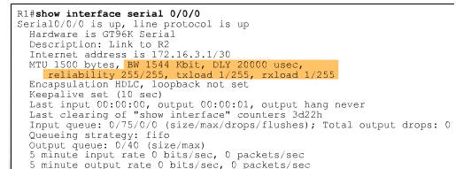
使用 show interfaces 命令来检查度量值

Slide 27
结束

